Slide 1
Data structures and algorithms In JavaScript

Slide 2
What can I Learn from this course?
You will learn how to Analyze the performance of the programs to choose which one is the best and write more efficient code programs. Big O Notation
You will learn Practical Algorithms used in real life situations like (Binary Search).
You will learn problem solving techniques like (divide and conquer and dynamic programming)
You will learn about searching and sorting algorithms like (bubble sort – selection sort – merge sort – radix sort – Quick sort ……)
You will learn about fundamental data structures and when to use them.
like(singly linked list – array – doubly linked list – stacks – Queues- Hash tables –
trees – graphs, …….)

Slide 3
Who should take this course?
Anyone who knows the basics of any programming language and wants to understand algorithms.
Any programmer/developer wants to write more efficient programs.
Any programmer/developer wants to pass the interview and get a job.

Slide 4
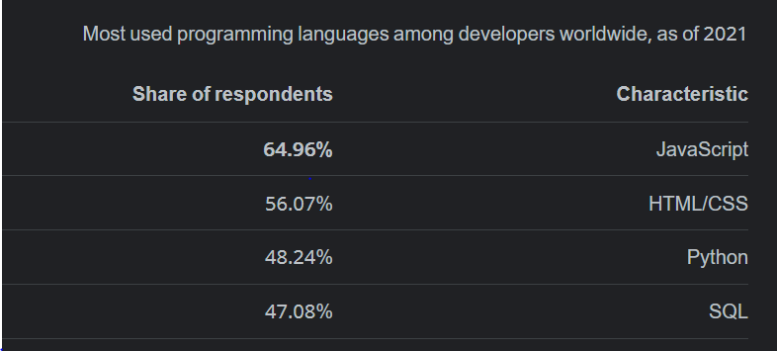
What is so special about the course?
Step by step teaching (every concept will be discussed very well)
Implementation in JavaScript which is very popular. So you will deal comfortably with this course.
Completed Course (from zero to hero)
Free and will still free
All resources will be available
Practical Exercises
Arabic content

Slide 5
How To study this course?
Recommended way
don’t step over videos
If you want to know specific topic
feel free to jump to any video but you should know the basics

Slide 6
Requirements
Basics of any programming language (Recommended JavaScript)
(variables, functions, loops, if else statements, Arrays, objects and classes)

